Slide 1
BLITHCHRON’17
THE BUTLER DID IT

Slide 2
EVENT
Walking in the darkness, doning the hat of Sherlock Holmes, TBDI presents you a new dimension of crime mystery thriller for you. Guys and gals interested in baffling your brains be ready to show your cunningness by solving a case in which only one truth prevails.

Slide 3
RULES
The competition is based on solving murder mystery or crime story.
2 members per team.
They will be shown a video based on above genres.
The video will not be shown again.
A document with detailed description of the characters of the video will be provided to each team.
Based on the story you will have to answer a particular set of questions.
The teams will be given sufficient but limted time to answer the questions.
The decisions of the judges will be final.

Slide 4
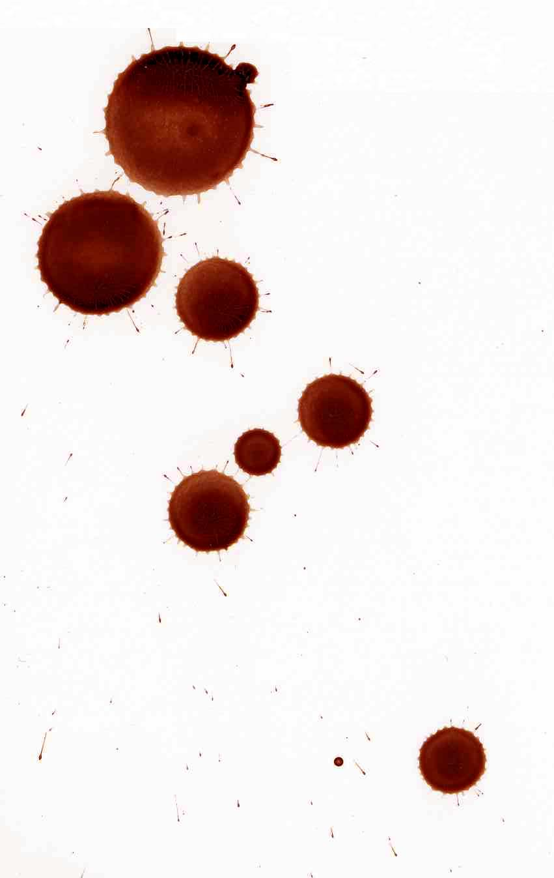
CONTACT US
Sarthak Mittal
sarthak.mittal@iitgn.ac.in
9558208600
Rishikesh More
more.rishikesh@iitgn.ac.in
7775063816
Anmol Gautam
anmol.gautam@iitgn.ac.in
9413075714

